Slide 1
TELECOMMUNICATION CUSTOMER CHURN PREDICTION USING MACHINE LEARNING TECHNIQUES
UNDER THE GUIDANCE

Slide 2
OBJECTIVE OF THE PROJECT
Customer churn is defined as the percentage of customers who stopped using a company's product or service during a specific time period. Predicting customer churn is a difficult but critical business problem, particularly in industries where the Cost of Customer Acquisition (CAC) is high, such as technology, telecom, finance, and so on. The ability to predict that a specific customer is at high risk of churning while there is still time to act represents a significant additional potential revenue source for businesses. The primary goal of the customer churn predictive model is to retain customers who are at high risk of churn by engaging with them proactively.

Slide 3
ABSTRACT
Customer churn is one of the most pressing issues confronting the Tele Communications Industry (TCI). Researchers and analysts use Customer Relationship Management (CRM) data to identify customers likely to churn using machine learning models. While several studies have been conducted in the context of Customer Churn Prediction (CCP) in TCI, a review of the performance of the various models derived from these studies reveals clear room for improvement. As a result, we investigated several machine learning models and data transformation methods to improve the accuracy of customer churn prediction in the telecommunications industry. To optimize the prediction models, the best hyperparameters were chosen using the grid search method, and the best features were chosen using a univariate technique.

Slide 4
MOTIVATION AND PROBLEM STATEMENT
Customer churn is a major issue in the telecommunications industry. According to a study conducted by the University of Zambia, telecom provider churn rates can reach as high as 67% per year. Dissatisfaction with various services was one of the leading factors. If you're working with large telecommunications datasets, binary classification can help with customer segmentation by categorizing your users based on a classification rule and certain attributes. You can predict how many customers are likely to opt out of service using machine learning techniques and a telecommunication data set. This project allows you to identify at-risk customers from various customer points, most notably a CRM system.

Slide 5
LITERATURE SURVEY
AUTHOR | TITLE | CONCEPT | PROS AND CONS
Shabankareh, M.J., Shabankareh, M.A., Nazarian, A., Ranjbaran, A. and Seyyedamiri, N., 2022. A Stacking-Based Data Mining Solution to Customer Churn Prediction. Journal of Relationship Marketing, 21(2), pp.124-147. | A Stacking-Based Data Mining Solution to Customer Churn Prediction. | This study used data mining algorithms to combine new methods for early churn identification while analyzing the data of the telecommunication sectors. | The outcomes demonstrate that the suggested churn prediction solution is accurate as suggested. It can be very time-consuming to train.

Slide 6
AUTHOR | TITLE | CONCEPT | PROS AND CONS
Sudharsan , R. and Ganesh, E.N., 2022. A Swish RNN-based customer churn prediction for the telecom industry with a novel feature selection strategy. Connection Science, 34(1), pp.1855-1876. | A Swish RNN based customer churn prediction for the telecom industry with a novel feature selection strategy. | Through the use of a deep learning model called the Swish Recurrent Neural Network, this work suggests an unique framework for predicting customer attrition (S-RNN). | They offer extraordinary memory abilities, are a very effective tool for dealing with sequence data, and may be applied in daily life. This neural network's computation is sluggish. Training can be challenging.

Slide 7
AUTHOR | TITLE | CONCEPT | PROS AND CONS
Samah Wael Fujo, Suresh Subramanian and Moaiad Ahmad Khder , Information Sciences Letters- An International Journal,2022 | Customer Churn Prediction in Telecommunication Industry Using Deep Learning | To assess the effectiveness of the model, various assessment techniques were applied, including 10-fold cross-validation and holdout. Both datasets were balanced using the Random Oversampling approach to address the imbalance. | For the same datasets, their Deep-BP-ANN model surpasses other deep learning approaches that use holdout or 10-fold CV in terms of accuracy. The effectiveness of the model was not evaluated against further machine learning methods like random forest and decision tree.

Slide 8
AUTHOR | TITLE | CONCEPT | PROS AND CONS
Tianyuan Zhang ,Sérgio Moro and Ricardo F. Ramos, Big Data Analytics, Privacy and Visualization,2022 | A Data-Driven Approach to Improve Customer Churn Prediction Based on Telecom Customer Segmentation | A telecom customer churn prediction model was created using data gathered from three significant Chinese telecom providers, Fisher discriminant equations, and logistic regression analysis. | The regression analysis-based telecom customer churn model produced better outcomes and had a higher prediction accuracy (93.94%). The assumption of linearity between the dependent variable and the independent variables is the main drawback of logistic regression.

Slide 9
AUTHOR | TITLE | CONCEPT | PROS AND CONS
Yajun Liu, Jingjing Fan, Jianfang Zhang, Xinxin Yin & Zehua Song , Journal of Intelligent Information Systems ,2022 | Research on telecom customer churn prediction based on ensemble learning | The multidimensional data preparation, feature extraction, and processing of the dataset made available by the telecom operator constitute the study's primary contributions. | Whether or not the dataset was balanced, especially in the imbalanced dataset, the churn forecast accuracy rate increased. It is less interpretable.

Slide 10
AUTHOR | TITLE | CONCEPT | PROS AND CONS
FE Usman-Hamza, AO Balogun, LF Capretz,”Intelligent Decision Forest Models for Customer Churn Prediction” - Applied Sciences, 2022 | Intelligent Decision Forest Models for Customer Churn Prediction | For CCP in telecommunications, they created intelligent decision forest (DF) models in this work. | Comparative results demonstrated that the suggested DF models offered the telecom industry's CCP improved prediction capabilities and appropriate solutions. the features of expected customer churns were not studied in this research endeavor.

Slide 11
AUTHOR | TITLE | CONCEPT | PROS AND CONS
Syed Fakhar Bilal, Abdulwahab Ali Almazroi, Saba Bashir​, Farhan Hassan Khan, Abdulaleem Ali Almazroi, PeerJ Computer Science, 2022, | An ensemble based approach using a combination of clustering and classification algorithms to enhance customer churn prediction in telecom industry | The suggested churn prediction model is an ensemble-based hybrid model that combines clustering and classification methods. | The suggested model had the highest prediction accuracy of 94.7% on the GitHub dataset and 92.43% on the Bigml dataset, according to the analysis of the results. Clustering has drawbacks, including complexity and the inability to repair faulty databases.

Slide 12
AUTHOR | TITLE | CONCEPT | PROS AND CONS
Shivani Vaidya and Rajesh kumar Nigam, International Journal of Electronics Communication and Computer Engineering , Volume 13, 2022 | An Analysis of Customer Churn Predictions in the Telecommunications Sector | This analysis shows that the most popular CCP approaches are Support Vector Machines, Naive Bayes, Decision Trees, and Neural Networks. The most popular data preparation technique is feature selection, which is followed by normalization and noise removal. | Selection of Features Enhances Accuracy. Improved modelling accuracy is a result of less misleading data. However, when there are not enough observations, the risk of overfitting increases.

Slide 13
AUTHOR | TITLE | CONCEPT | PROS AND CONS
Mohammad TabrezQuasim, Adel Sulaiman, Asadullah Shaikh and Mohammed Younus, Sustainable Computing: Informatics and Systems Volume 35, 2022 | Blockchain in churn prediction based telecommunication system on climatic weather application | The key pair used in asymmetric cryptography, which supports system security, is examined in the current work. The classifier methods of recurrent neural network (RNN) and support vector machine (SVM) treat both present and potential customers as stable. | The suggested concept structures the consumer situation and creates a proactive customer re-engagement using mobile-based telecommunication technologies. When the target classes overlap and the data set has more sound, it does not operate very well.

Slide 14
AUTHOR | TITLE | CONCEPT | PROS AND CONS
P Jeyaprakaash Sashirekha K,JOURNAL OF PHARMACEUTICAL NEGATIVE RESULTS, Volume 13,2022 | Accuracy Measure of Customer Churn Prediction in Telecom Industry using Adaboost over Decision Tree Algorithm | For determining the efficacy of predicting customer turnover, the Adaboost algorithm and Decision Tree method are used with a sample size of 10 and multiple training and testing splits, respectively. | Both the Adaboost algorithm (90%) and the Decision Tree method (73%) have been found to be accurate at predicting client attrition. Noisy data and outliers have to be avoided before adopting an Adaboost algorithm.

Slide 15
AUTHOR | TITLE | CONCEPT | PROS AND CONS
Sulaiman Olaniyi Abdulsalam, Micheal Olaolu Arowolo, Yakub Kayode Saheed, Jesutofunmi Onaope Afolayan, Indonesian Journal of Electrical Engineering and infomatics, 2022 | Customer Churn Prediction in Telecommunication Industry Using Classification and Regression Trees and Artificial Neural Network Algorithms | The main goal of this research is to build a churn prediction model that aids telecom operators in identifying clients who are most likely to experience churn. | The accuracy of the classification using CART and ANN to measure the model's performance reveals that ANN has a higher predictive capacity than the 91.60% CART classifier. Training data is noisy, complex sensor data.

Slide 16
AUTHOR | TITLE | CONCEPT | PROS AND CONS
Maryam Sadeghi, Mohammad Naderi Dehkordi, Behrang Barekatain & Naser Khani , The Journal of Supercomputing ,2022 | Improve customer churn prediction through the proposed PCA-PSO-K means algorithm in the communication industry | In this study, a novel system named PCA-PSO-K Means algorithm is introduced. It integrates the principal component analysis (PCA), the classification-focused K Means algorithm, and the particle swarm optimization (PSO) algorithm. | The proposed system has a correlation coefficient of 0.4430.271, a sensitivity of 75%, a specificity of 99.81%, and an accuracy of 99.77%. Accuracy depends on the quality of the data.

Slide 17
AUTHOR | TITLE | CONCEPT | PROS AND CONS
Teoh Jay Shen, Abdul Samad Bin Shibghatullah, Journal of Advances in Artificial Life Robotics Vol. 3(2), 2022 | Customer Churn Prediction Model for Telecommunication Industry | The suggested models created in this work combine machine learning and deep learning techniques. | These models used four different machine learning and deep learning methods: Artificial Neural Network, Self-Organizing Map, Decision Tree, and a hybrid model. It requires neuron weights be necessary and sufficient to cluster inputs.

Slide 18
AUTHOR | TITLE | CONCEPT | PROS AND CONS
Zeynep Hilal KİLİMCİ, International Journal of Computational and Experimental Science and Engineering, Volume 8, 2022 | The Effectiveness of Homogeneous Classifier Ensembles on Customer Churn Prediction in Banking, Insurance, and Telecommunication Sectors | To predict client churn in a variety of industries, including banking, insurance, and telecommunications, an ensemble-based methodology is provided. | When feature extraction is done, the random forest algorithm can forecast customer churn with 89.93% accuracy in banking, 95.90% accuracy in communications, and 77.53% accuracy in insurance sectors. A large number of trees can make the algorithm too slow and ineffective for real-time predictions

Slide 19
AUTHOR | TITLE | CONCEPT | PROS AND CONS
P. Ramesh, J. Jeba Emilyn & V. Vijayakumar , Wireless Personal Communications volume 124, pages1695–1709, 2022 | Hybrid Artificial Neural Networks Using Customer Churn Prediction | The Artificial Neural Networks (ANN), Random Forests (RF), and datasets from the telecommunications sector are used in the study to identify the variables that affect customer attrition. For predicting CCP, a hybrid ANN-based method is proposed. | The maximum accuracy reached by ANN-2 and ANN-4 hidden layers is 88.14% and 90.34%, respectively. Inadequate generalisation, overfitting, and initial parameter value uncertainty

Slide 20
EXISTING SYSTEM
The company used a machine learning model after learning how data is collected and how to create a churn target (which is one of the more difficult components of the challenge).
A model was fed the history of customer churn from left to right (event period for X features and performance window for target variable).
Each month, the active customer base was loaded into a machine learning predictive model to calculate the likelihood that each client will cancel their subscription (in business lingo, this is sometimes called a score of churn).

Slide 21
PROPOSED SYSTEM
To predict whether or not a customer would depart, the ensemble Machine Learning (ML) technique has been researched. Some performance metrics that will be used to evaluate the eventual performance of the best models are accuracy, recall, and precision. An ensemble methodology has been evaluated to identify whether a customer has left the business in the last month. By integrating the predictions of several base estimators built using a particular learning process, ensemble methods aim to boost robustness. The objectives of the proposed work are formulated below. Since the dataset is imbalanced class-weighted/cost-sensitive learning has been utilized. In cost-sensitive learning, a weighted cost function is used.

Slide 22
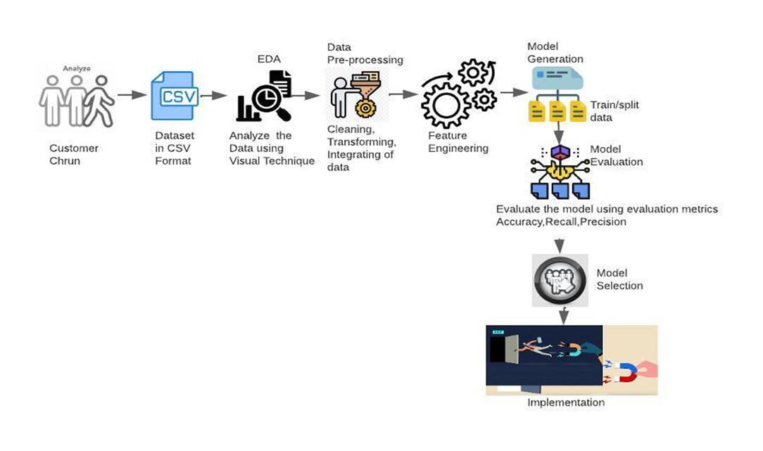
PROPOSED ARCHITECTURE

Slide 23
HARDWARE AND SOFTWARE REQUIREMENTS
1. Hardware Requirements :
Intel or ARM-based processor, minimum Pentium or equivalent
Minimum 512MB RAM
Minimum 4GB disk space
2. Software Requirements :
Jupyter notebook
Anaconda
Pandas
Numpy

Slide 24
LIST OF MODULES
Dataset Preparation
Exploratory Data Analysis
Data Pre-processing/Cleaning
Model Building
Evaluation of Models
Deploying the model

Slide 25
Dataset Preparation
The data set includes information about:
Customers who left within the last month – the column is called Churn
Services that each customer has signed up for – phone, multiple lines, internet, online security, online backup, device protection, tech support, and streaming TV and movies
Customer account information – how long they’ve been a customer, contract, payment method, paperless billing, monthly charges, and total charges
Demographic info about customers – gender, age range, and if they have partners and dependents

Slide 26
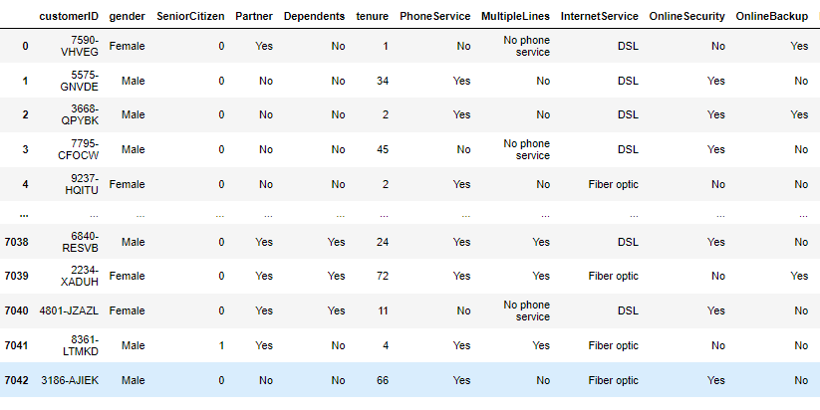
Fig: Features in the data set

Slide 27
Exploratory Data Analysis
Several actions are taken to explore the data after data gathering. Understanding the data structure, performing basic preprocessing, cleaning the data, identifying patterns and discrepancies in the data (such as skewness, outliers, and missing values), and developing and validating hypotheses are the objectives of this module.
EDA's initial section evaluates the data frame's structure, columns it contains, and data kinds. The objectives of this step are to gain a general grasp of the data set, assess domain knowledge, and gather preliminary suggestions for research topics
Correlation, r, measures the linear association between two quantitative variables. Correlation measures the strength of a linear relationship only. (See the following Scatterplot for display where the correlation is 0 but the two variables are obviously related.)
Since “total charges" is the sum of all monthly charges across a customer's tenure, as shown by the correlation matrix and reap lots, “total charges" is strongly connected with “monthly charges" and "tenure".
When looking for a correlation between two nominal variables, Cramer's V is a better choice than Pearson correlation. The Cramer's V measure is used in this situation.

Slide 28
The Churn plot reveals that the dataset is unbalanced (bottom right corner).
It is possible to display the frequency distribution of data in a table or graph. Frequency tables, histograms, and bar charts are a few popular ways to display frequency distributions. A frequency table is an easy way to show how frequently a certain value or feature occurs.
We can state that the majority of consumers who churn have monthly fees between 70 and 110 and tenures between 0 and 20 months.
Short duration clients make up 50% of the churned customers and 50% of the churned revenue. This also implies that clients with short duration pay higher monthly fees than those with long tenure. Therefore, a significant portion of the revenue can be kept if the ML models are successful in detecting the low tenure consumers.
We can infer that the majority of the customers who are churned do not have monthly contracts, are not senior citizens, do not have dependents, do not subscribe to online security services or technical support, do not have Fiber internet service, do not have paperless billing, and do not have phone service subscriptions.

Slide 29
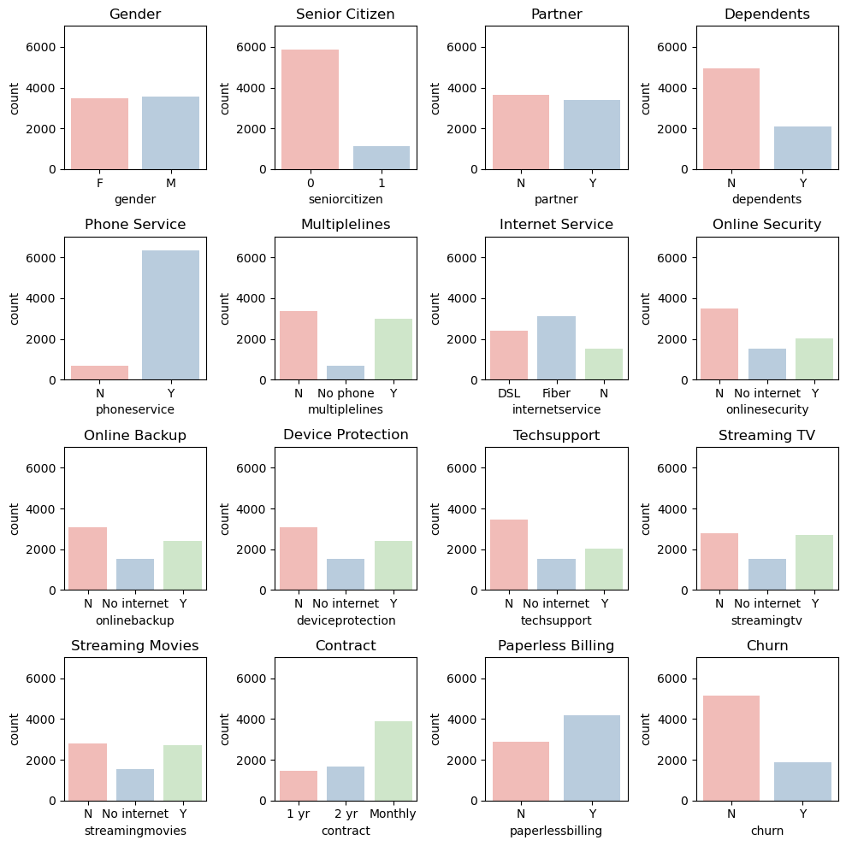
Fig: Churn among categorical values

Slide 30
Data Pre-processing
Data pre-processing is one of the most important stages of information discovery activities. It necessitates a number of steps, including data transformation and reduction. When raw data is converted into low-quality data, the efficiency and accuracy of learning algorithms are compromised. Thus, by performing proper data preprocessing steps and selecting appropriate learning algorithms, the collected data can be correctly analyzed. Missing values, non-numeric features, inconsistent feature scales, and other issues plague telecom datasets. As a result, it is critical to pre-process the data before implementing a learning model. Handling missing data and encoding categorical variables using label encoding are all part of the pre-processing phase. Furthermore, using the normalization technique to scale the high variance values and removing the unnecessary features that do not affect the dependent variable. The EDA shows that both datasets are imbalanced, and we used the cost-sensitive learning technique to address this issue. The below figure describes that there is a Class Imbalance in the target of our dataset, where data entries for "No" is counted at 5174, whilst data entries for "Yes" is counted at only 1869. In our case, the data entries for those with target outcome "Yes" (or Class 1) is only 26.53% of the dataset as a whole. Therefore, there is a mild imbalance in our data.

Slide 31
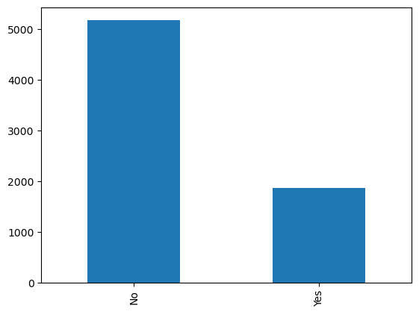
Fig: Class imbalance

Slide 32
Missing data
Missing data has an impact on statistical analysis due to knowledge loss and irregularities in data patterns. Because the dataset contains missing values, it is critical to understand the percentage of missing values and their location. The total charges have 0.16% missing values, which is less than 30%. As a result, missing data in both data sets are handled using the simple imputer technique. Simple Imputer is a program that is used to impute or replace missing continuous and categorical variables with various means, medians, most frequent values, and constant values. Because the missing values in dataset 29 are less than 30%, the best strategy for dealing with them is to fill the null with the mean of each specific feature.

Slide 33
Data Transformation
Data transformation techniques can significantly improve the overall performance of churn prediction. On the data set, three different data transformation methods were used: Normalization and label encoding.
Label Encoding (LE) is a fundamental technique for mapping categories as continuous integers into nominal attributes. The LE technique is more useful for categorical variables with only two distinct values, such as (yes or no) and (male or female). Gender, partner, dependents, phone service, paperless billing, and churn are six categorical variables with two unique values in the IBM Telco data set. These characteristics were encoded using the LE technique, with yes replaced by one and no replaced by zero, and male replaced by one and female replaced by zero.
Normalization: The dataset was normalized to improve the results of machine learning methods for customer churn prediction. MinMaxScaler is one of the most commonly used normalization methods. By rescaling variables into the range (0,1), MinMaxScaler scales and translates each feature individually. When categorical features are already encoded, the MinMax Scaler is applied only to the high-variance features, not the entire data set; otherwise, it causes over-rescaling. There are many other techniques for rescaling values, such as standardization and binarization, but after some testing, normalization yields the best performance results.

Slide 34
Handling Imbalanced dataset
One of the predictive modeling classification problems used in this study is imbalanced classification. An imbalance occurs when one or more classes have low proportions in the training results in comparison to the other classes. In our case, the churn class has much lower proportions than the non-churn class. 30 Customers' features, for example, have 80 instances of customers who have not churned and 20 instances of customers who have churned, and our training dataset only contains these instances. This is an example of an unbalanced classification problem. The CCP faces new challenges as a result of class disparities. As a result, the IBM Telco dataset was discovered to be unbalanced, as the percentage of the second (minority) class representing churn customers in IBM Telco’s dataset is approximately 26.5%. To tackle this problem, a cost-sensitive learning technique was used. When training a machine learning model, cost-sensitive learning takes into account the costs of prediction errors (as well as potentially other costs). It is a branch of mathematics that is closely related to imbalanced learning and is concerned with the classification of datasets with skewed class distributions. As a result, many of the concepts and techniques developed and applied for cost-sensitive learning can be adopted for imbalanced classification problems.

Slide 35
Model Building
Since this classification problem lacks linearity, the tress-based Ensemble technique has been applied for modeling. A class weightage of 1:3 has also been applied to address the 1:3 class imbalance, which means false negatives now cost three times as much as false positives. With the understanding that there has been no data leakage, the model was constructed using 80% of the data and verified using the remaining 20%. The genetic algorithm was used to tune the random forest model's many hyperparameters since it proved to be the most effective tuning technique while simultaneously preventing overfitting. A Random Forest model is a special classifier composed of a collection of simple classifiers (Decision Trees), each of which votes for the most popular class in the input. Random Forest does not require the use of cross-validation techniques or verification on a separate set of variables in order to provide an impartial evaluation of the error, as this is inherent in the method. In fact, each 31 tree is constructed using a different bootstrap sample of the original data, while the cases that were not chosen for tree construction are used to estimate the model's errors. This model is simple to use because it requires only two parameters to be entered (the number of variables in the subset of random variables used in each node and the number of trees in the forest) and is not overly sensitive to their values. The performance of a classification model is then assessed by creating a confusion matrix, which is a table. A calculation of accuracy was made using the confusion matrix.

Slide 36
MODEL OPTIMIZATION
Hyperparameter tuning has been used to optimize the learning model. Hyperparameter tuning is choosing a set of optimal hyperparameters for a learning algorithm. The selection of machine learning hyperparameters can have a significant impact on an algorithm's performance, making it a time-consuming yet essential operation. Important machine learning pipelines phases like feature engineering and result interpretation are delayed by manual tuning. Although hands-off, grid and random searches take a long time to complete because they waste time assessing unproductive parts of the search field. The process of adjusting hyperparameters is increasingly done automatically, with no manual work required beyond the initial setup. The goal is to locate the best hyperparameters quickly using an educated search. While using Automatic Hyperparameter Tuning, the model hyperparameters to use are found using approaches such as 32 Bayesian Optimization, Gradient Descent, and Evolutionary Algorithms.

Slide 37
Random Search
A parameter space with a certain distribution can have a specific number of candidates sampled from it. Following a description of these tools, we go over best practices that apply to both strategies. The grid of hyperparameters used in Random Search was built, and we trained/tested our model using only a haphazard combination of these hyperparameters. The training set has undergone cross-validation. To ensure that our model is not overfitting our data while utilizing Cross- Validation, the training set was split into N additional partitions. K-Fold Validation is one of the Cross-Validation techniques that are most frequently employed. In K- Fold, our training set has been divided into N partitions and then iteratively trained the model using N-1 partitions and tested it with the left-over partition (at each iteration we change the left-over partition). Once the model has been trained N times, we average the training outcomes from each iteration to get our overall training performance results.

Slide 38
Bayesian Optimization
While the ultimate goal of Bayesian optimization, a model-based method for finding the minimum of a function, is to identify the input value to a function that can yield the lowest feasible output value, it outperforms random search in terms of performance while requiring fewer iterations. Hence, Bayesian Optimization may result in faster optimization and improved testing performance. By selecting the input values while taking into account the results of previous iterations, Bayesian Optimization can lower the number of search iterations. By doing this, we may focus our search right away on values that are near to the results we want.

Slide 39
Genetic Algorithm
A genetic algorithm (GA) is a metaheuristic inspired by natural selection that belongs to the larger class of evolutionary algorithms in computer science and operations research (EA). Genetic algorithms, which rely on biologically inspired operators such as mutation, crossover, and selection, are commonly used to generate high-quality solutions to optimization and search problems. Natural selection mechanisms are attempted to be applied to Machine Learning contexts by Genetic Algorithms. Because they are inspired by the Darwinian process of Natural Selection, they are also known as Evolutionary Algorithms. Assume we build a population of N Machine Learning models with predefined Hyperparameters. The TPOT Auto Machine Learning library was used to implement Genetic Algorithms in Python. TPOT is based on the sci-kit-learn library and can perform both regression and classification tasks

Slide 40
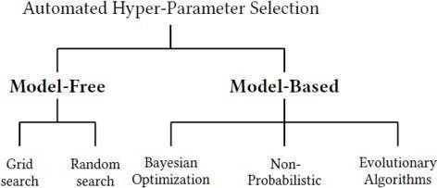
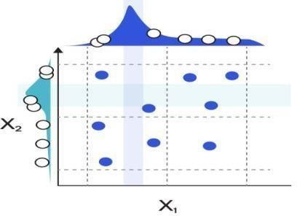
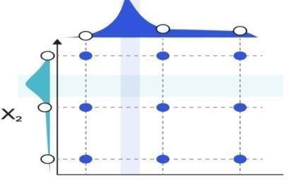
Fig: Hyperparameter tuning
Fig: Random search
Fig: Grid search

Slide 41
Comparison of Models
The performance of models, which divide the original data into sections, is evaluated via cross-validation. The test set is used to assess the performance of models, whereas the training set is used to train the model. Since the out-of-sample data are also evaluated, cross-validation is helpful in producing a stable and reliable model. The average of all exams makes up the overall performance.
To rate the performance of models, accuracy, precision, recall, F1-score, and AUC are taken into consideration. The percentage of samples that the model properly predicts for all samples is known as accuracy. Precision is the percentage of samples that are actually positive compared to those that are expected to be positive.
Specificity measures how many negative examples in the real sample are accurately predicted, while recall measures how many positive examples in the actual sample are correctly predicted. The F1-score is produced by expanding on the basis of these four metrics. The outcomes of Precision and Recall are combined. The equations are written as, Where, TP (True Positive) signifies that the sample is both really and correctly expected to be positive.
False Negative (FN) signifies that the sample is actually positive even though it was expected to be negative.
FP (False Positive) denotes a sample that was expected to be positive but is really negative.
TN (True Negative) denotes that the sample is both genuinely and predictably negative.

Slide 42
Deployment of Model
Deploying a machine learning model simply refers to integrating the model into an already-existing production environment that can accept an input and produce a useful output for business decision-making. One component of the data is the model that is built/trained using different techniques on a large dataset. However, implementing machine learning in the actual world requires two steps, the first of which is employing these models in various applications.
The model needs to be deployed online so that users from the outside world can use it in order to forecast the new data. With the help of Flask, a web application was built utilizing the machine learning model Random Forest with Genetic algorithm tuning. We will build a simple HTML webpage to accept the measurements as input and classify the variety based on the classification model. Although there are competing frameworks on the market, such as FastAPI, streamlit is one of the most popular and well-respected frameworks among machine learning experts for deploying models.

Slide 43
CONCLUSION
Customer retention is essential in a market that is competitive. This project used a genetic approach to implement hyperparameter adjustment in the Random Forest Classifier while taking the dataset into account. According to the telecom customer churn prediction model built using a random forest method with genetic algorithm tuning, churn can be anticipated when customers are dissatisfied with the service that is being delivered. The model achieved 80% accuracy. Also, as our findings indicate that customers with short contracts are more likely to churn, the telecom sector should make a compelling offer to entice customers to sign up for one or two years. Since our findings indicate that fiber optic service subscribers
are more likely to churn than other consumers, the telecom sector ought to offer a good discount to these customers. The telecom sector should steer clients towards using mailed checks, bank transfers, or credit cards instead of electronic check methods for paying financial receivables. The findings demonstrate that customers who use electronic checks as their primary form of payment are more likely to leave. Since customers who are not provided with technical help are more likely to leave a telecom company, the industry should pay greater attention to this area.

Slide 44
Future Enhancement
Using hybrid classification algorithms, future research in this area will concentrate on the connections between client lifetime value and churn prediction that already exist. By selecting the appropriate dataset variables, it is important to consider the retention policies. Due to the passive and dynamic nature of the sector, data mining will play a bigger role in the future of the telecommunications business.

Slide 45
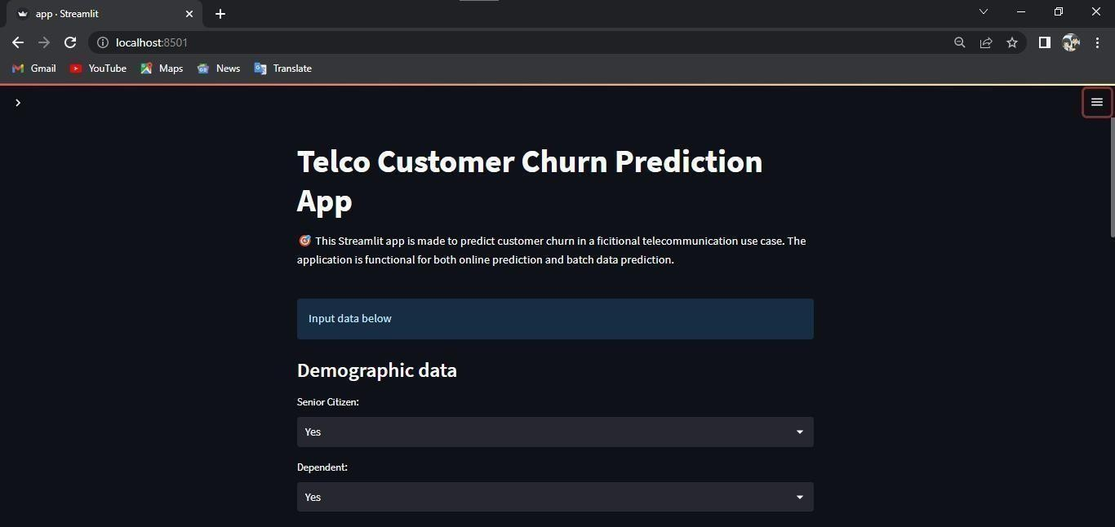
IMPLEMENTATION

Slide 46
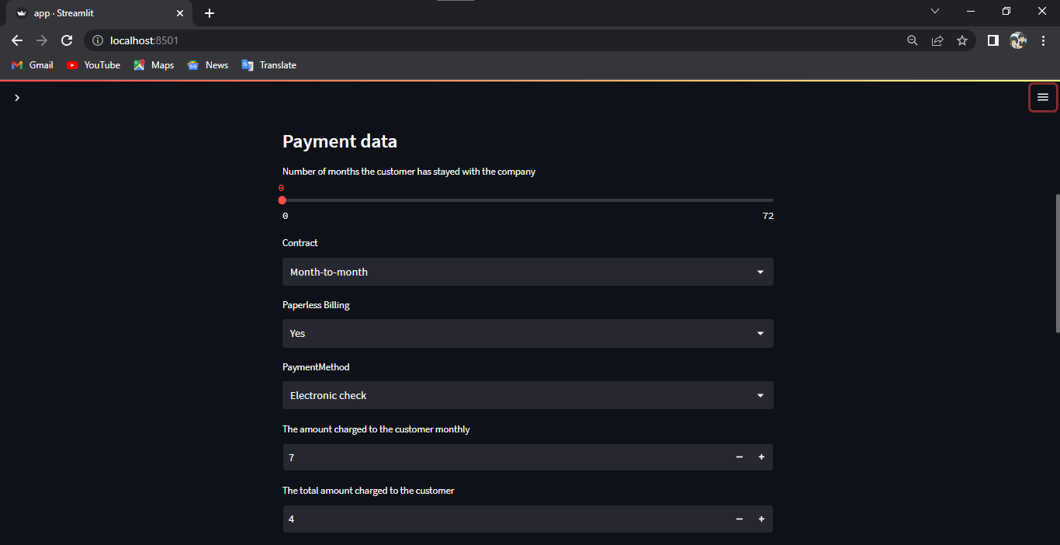

Slide 47
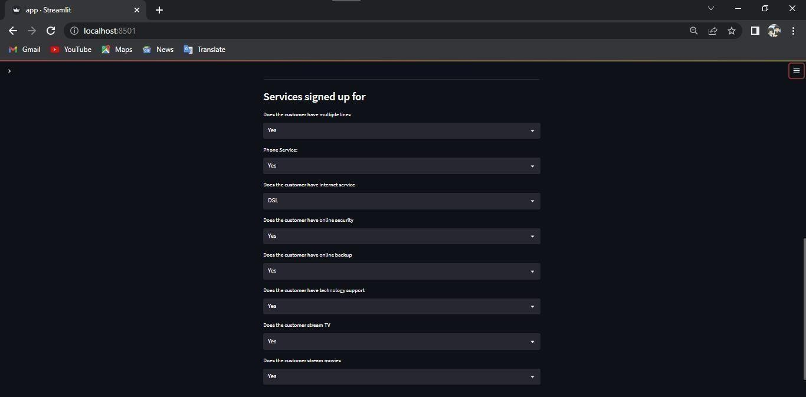

Slide 48
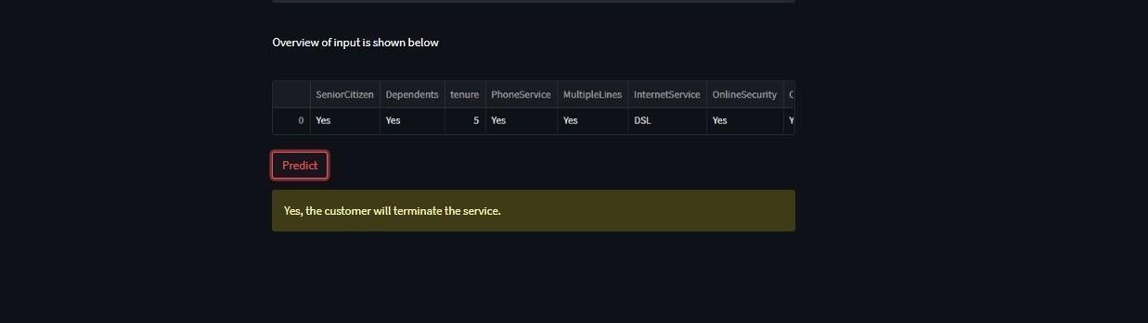

Slide 49
REFERENCES
[1] Shabankareh, M.J., Shabankareh, M.A., Nazarian, A., Ranjbaran, A. and Seyyedamiri, N., 2022. A Stacking-Based Data Mining Solution to Customer Churn Prediction. Journal of Relationship Marketing, 21(2),pp.124-147.
[2]Sudharsan, R. and Ganesh, E.N., 2022. A Swish RNN based customer churn prediction for the telecom industry with a novel feature selection strategy. Connection Science, 34(1), pp.1855-1876.
[3]Samah Wael Fujo, Suresh Subramanian and Moaiad Ahmad Khder , Information Sciences Letters- An International Journal,2022
[4]Tianyuan Zhang ,Sérgio Moro and Ricardo F. Ramos, Big Data Analytics, Privacy and Visualization,2022
Yajun Liu, Jingjing Fan, Jianfang Zhang, Xinxin Yin & Zehua Song , Journal of Intelligent Information Systems ,2022
FE Usman-Hamza, AO Balogun, LF Capretz - Applied Sciences, 2022
Syed Fakhar Bilal, Abdulwahab Ali Almazroi, Saba Bashir, Farhan Hassan Khan, Abdulaleem Ali Almazroi, PeerJ Computer Science, 2022,
Shivani Vaidya and Rajesh kumar Nigam, International Journal of Electronics Communication and Computer Engineering , Volume 13, 2022

Slide 50
[5] Yajun Liu, Jingjing Fan, Jianfang Zhang, Xinxin Yin & Zehua Song, “Research on telecom customer churn prediction based on ensemble learning”, Journal of Intelligent Information Systems,2022
[6] FE Usman-Hamza, AO Balogun, LF Capretz,” Intelligent Decision Forest Models for Customer Churn Prediction” - Applied Sciences, 2022
[7] Syed Fakhar Bilal, Abdulwahab Ali Almazroi, Saba Bashir, Farhan Hassan Khan, Abdulaleem Ali Almazroi, PeerJ,” An ensemble-based approach using a combination of clustering and classification algorithms to enhance customer churn prediction in telecom industry”, Computer Science, 2022,
[8] Shivani Vaidya and Rajesh Kumar Nigam, ”An Analysis of Customer Churn Predictions in the Telecommunications Sector International”, Journal of Electronics Communication and Computer Engineering, Volume 13, 2022
[9] Mohammad TabrezQuasim, Adel Sulaiman, Asadullah Shaikh and Mohammed Younus,” Blockchain in churn prediction based telecommunication system on climatic weather application”, Sustainable Computing: Informatics and Systems Volume 35, 2022

Slide 51
[10] P Jeyaprakaash , Sashirekha K, ”Accuracy Measure of Customer Churn Prediction in Telecom Industry using Adaboost over Decision Tree Algorithm”, JOURNAL OF PHARMACEUTICAL NEGATIVE RESULTS, Volume 13,2022
[11] Sulaiman Olaniyi Abdulsalam, Micheal Olaolu Arowolo, Yakub Kayode Saheed, Jesutofunmi Onaope Afolayan, ”Customer Churn Prediction in Telecommunication Industry Using Classification and Regression Trees and Artificial Neural Network Algorithms”, Indonesian Journal of Electrical Engineering and informatics, 2022
[12] Maryam Sadeghi, Mohammad Naderi Dehkordi, Behrang Barekatain & Naser Khani, ”Improve customer churn prediction through the proposed PCA- PSO-K means algorithm in the communication industry”, The Journal of Supercomputing ,2022
[13] Teoh Jay Shen, Abdul Samad Bin Shibghatullah, ”Customer Churn Prediction Model for Telecommunication Industry”, Journal of Advances in Artificial Life Robotics Vol. 3(2), 2022

